Slide 1
Military Support
Hawk Eye Elementary
2023-24
Address: 4321 Old Maxton Rd
Red Springs, NC 28376
Phone: (910) 875-2470

Slide 2
After this session, we will . . .
•Understand military family life and culture.
•Identify supports and resources necessary for military families to thrive.
•Commit to one tangible, sustainable act of support for families.

Slide 3
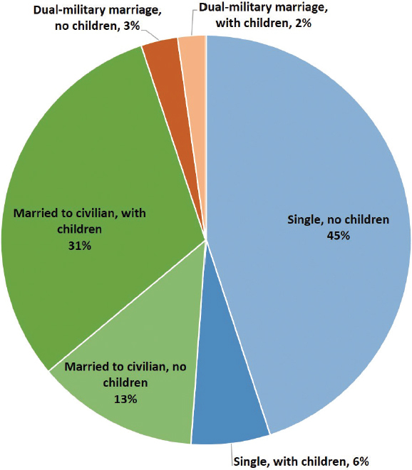
Family Status of Service Members
FIGURE 3-5 Family status of all service members (percent distribution)
SOURCE: Data from DoD (2017, pp. 134, 158).

Slide 4
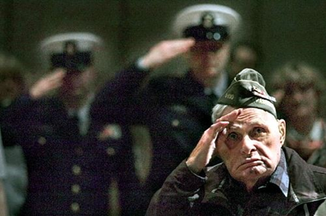
Military Culture
Culture is the knowledge, experience, values, ideals, attitudes, and symbols that are passed on from more experienced members of a community to new members.

Slide 5
Celebrating Military Children
The Defense Department celebrates military children during the month of April. There are more than 1.6 million military children who face many challenges and unique experiences as a result of their parents' service.
Each year, the DOD joins national, state and local government, schools, military serving organizations, companies and private citizens in celebrating military children and the sacrifices they make.
While military members serve around the world, we often forget the challenges faced by their children. Military families move on average every two to three years, impacting military children through changing schools and support networks.
Information from: https://www.defense.gov/Spotlights/Month-of-the-Military-Child/

Slide 6
Resources for Military Families
Army Community Services
Tutor.com
Students can chat 24/7 with a live tutor in all core subjects and at all skill levels including essay writing, math, science, and more.
Military One Source Tutors
https://military.tutor.com
800-342-9647
Private nonmedical counseling for free. Coaching and consultations 24/7
United States Army Child and Youth Services
https://https://www.armymwr.com/programs-and-services/cys
910-432-1023
Important services include transition support, deployment support, and home school linkages.
Specialty Behavioral Health (SpBH) Groups
910-907-8272
Anger Management, Couples Conflict Resolution, and Women’s Empowerment Groups.
Exceptional Family Member Program (EFMP)
https://liberty.armymwr.com/programs/acs/exeptional-familymember-program
Hoke County Schools
School Liaison Officer
Iris Pierce
(910) 432-1023
iris.d.pierce.naf@mail.mil

Slide 7
Resources Continued…
Operation: We Are Here Resources for military connected families and educators.
National Association of Federally Impacted Schools NAFIS advocates for federally impacted school districts and the students they educate
Military OneSource Support for active-duty service members and their families.

